Slide 1
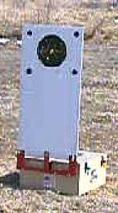

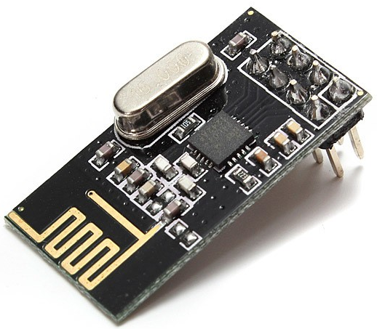

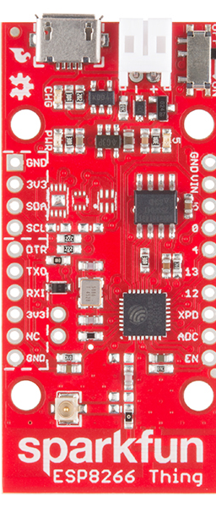
NRF24L01
Transceiver
NRF24L01
Transceiver
Wi-Fi
HTTP
RF
SPI
SPI
Microcontroller TBD
Controlling
Base Station
Located next to the shooter
Web browser device
Target Controller
Embedded in target
Mechanical Target
ESP8266
*Access point
*Web server

